Slide 1
Wearable Technology
For
O’Reilly
Android OPen

Slide 2
Agenda
Scenarios
Technology
Company
Discussion

Slide 3
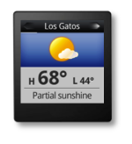

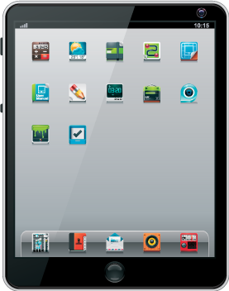
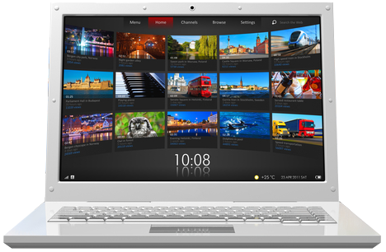

Inevitable Progression
INCREASED
ACCESSIBILITY
AVG SESSIONS
PER DAY
FIXED
Portable
pocketable
Wearable
SESSION SPEED
(GLANCEABILITY)

Slide 4
1
Micro Experiences

Slide 5

FLIGHT 422
DEPARTS 6:55PM
GATE 3B
ON TIME
Notes:
Business professional: subtle immediate glance at personal information

Slide 6

01:18:36
AVG MPH: 13
HEART RATE: 153
ON TARGET
Notes:
From general fitness to professional sports for connection to biosensors

Slide 7

foursquare
LONDON PLAZA HOTEL
1348 1ST AVE
CHECKED IN
Notes:
Which brings us back to FourSquare for the rest of us: social media for regular people, but with subtle immediacy.

Slide 8

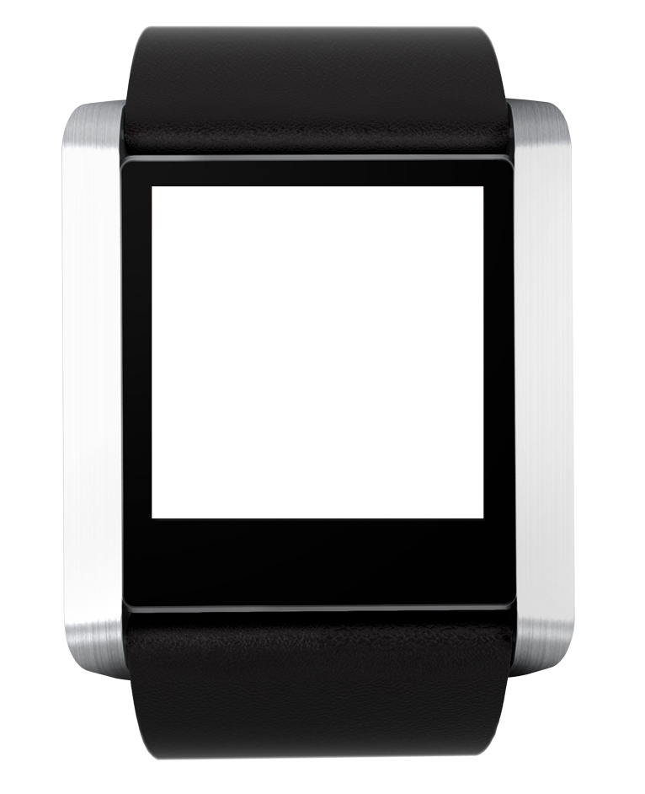


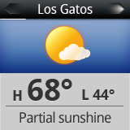
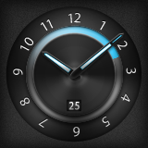
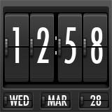
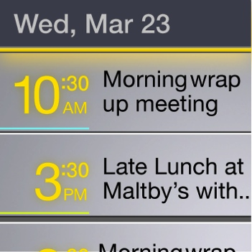
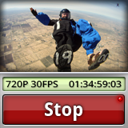
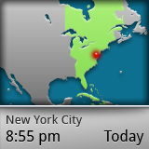

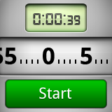
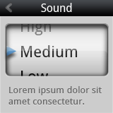
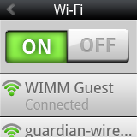
Micro Apps

Slide 9
2
WIMM Platform

Slide 10
Demo
Standby Mode
Watchfaces
Productivity Micro Apps
Social Micro Apps
Smartphone Companion
Owner Site

Slide 11
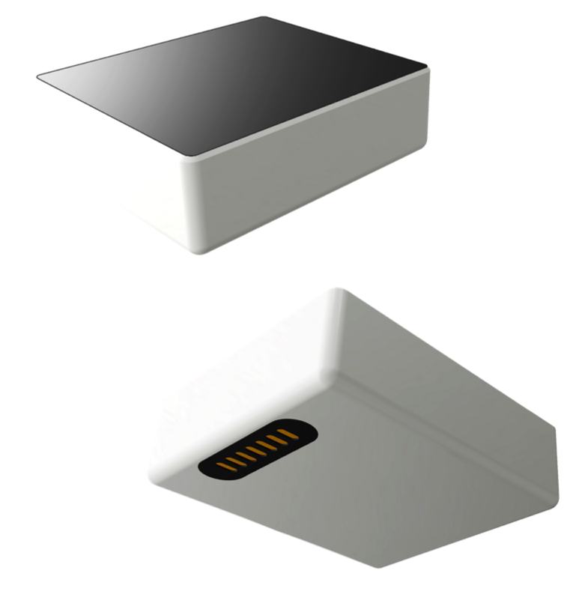
The WIMM Module
TECH SPECS
BI-MODAL CAPACATIVE TOUCHSCREEN
WI-FI
BLUETOOTH
GPS
ACCELEROMETER
MAGNETOMETER
AUDIBLE AND TACTILE ALERTS
UP TO 32GB MEMORY
WATER RESISTANT
32×36×12.5mm
22g
Software
  Android OS
Hardware
  Always on
  Lasts all day

Slide 12
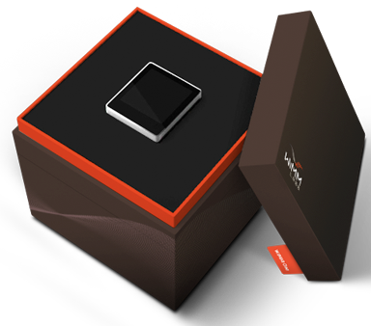
WIMM One
Developer Preview
To registered developers
$299
Limited supply
Available in several weeks

Slide 13
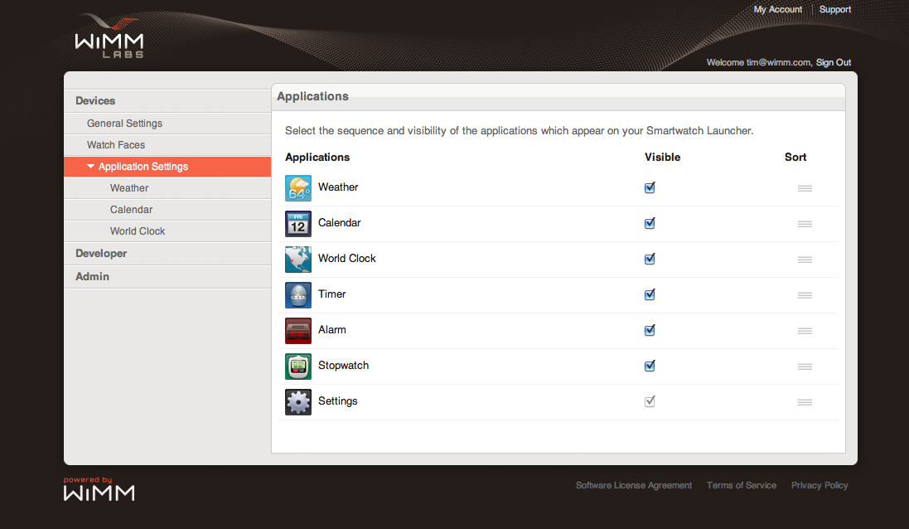
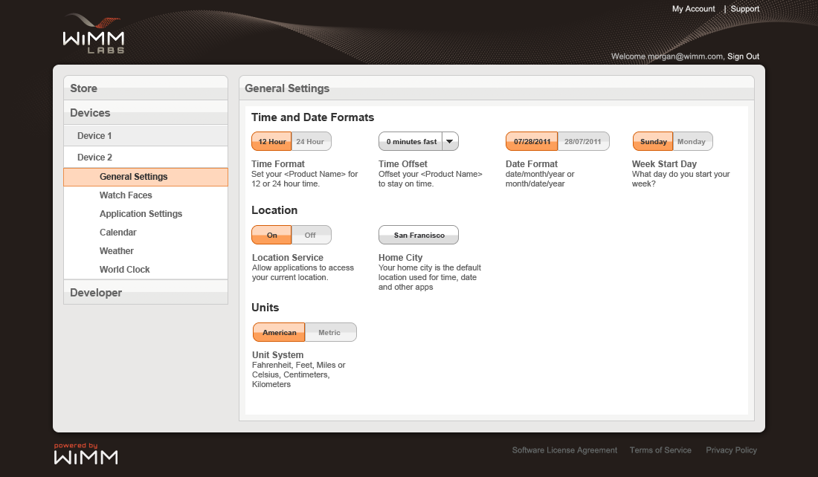
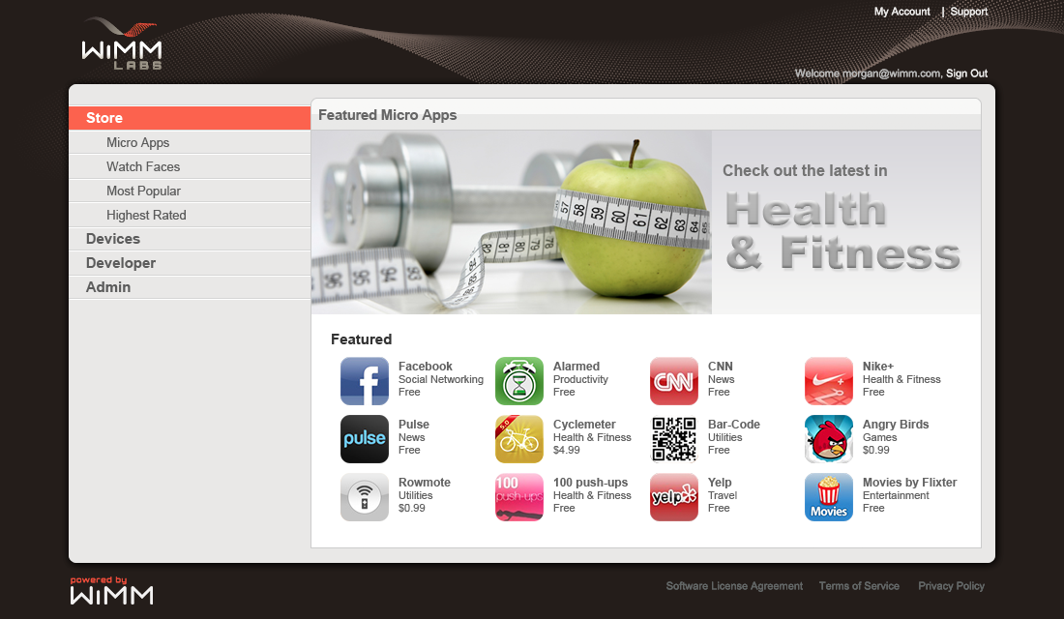
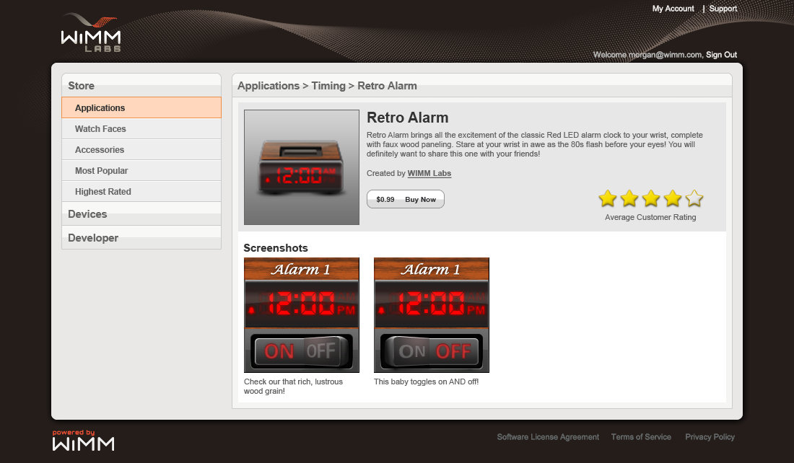
Web Services
Owner site
App store

Slide 14
Development Kits
Software
  20 WIMM-specific APIs on top of Android
  Tutorials and Sample Code
  Emulator
Hardware
  Dimensions
  Material recommendations

Slide 15
3
wimm Labs

Slide 16
A business model built for scale
brands,
sector expertise,
distribution
developers,
micro apps
investment, manufacturing support
Licensees
Android
Foxconn

Slide 17
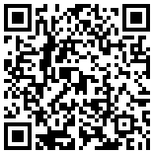
Open technology platform for personalized micro experiences through wearable devices
Ted Ladd
Director, Developer Relations
ted@wimm.com
@WIMMDev

